Slide 1
Cooper’s Pictures/Schematics

Slide 2
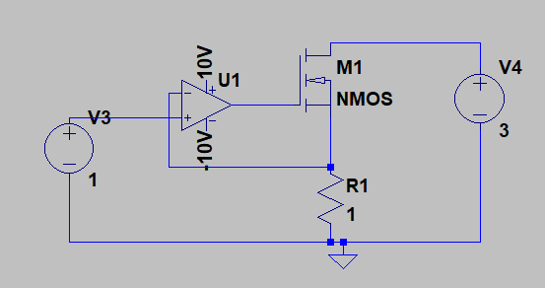
First attempt at Constant Current Electronic Load (LTSpice)

